Slide 1
ISC213 Introduction to Cognitive Science [2-0-0-2] Course Details
Presented by
Dr. Selvi C
Assistant Professor
IIIT Kottayam

Slide 2
Course Objectives
To study the basic concepts and approaches in the field of cognitive science
To apply the concepts of planning, reasoning and learning models in cognitive applications
To analyse language and semantic models of cognitive process.

Slide 3
Course Outcomes
Demonstrating the qualitative and quantitative skill and critical thinking on cognitive science by applying suitable methodology to real world cognitive applications
Acquire knowledge in language processing and understanding
Learning the cognitive processes of humans, robots and other intelligent systems

Slide 4
Syllabus
Introduction to Cognitive Science: Fundamental Concepts of cognitive science - Computers in Cognitive Science – Applied Cognitive Science - The Interdisciplinary Nature of Cognitive Science - Structure and constituents of the brain; Brief history of neuroscience; Mathematical models; Looking at brain signals; Processing of sensory information in the brain.
Memory: Types of Memory – Memory Models – Visual Imagery - Problem Solving - Overall Evaluation of the Cognitive Approach.

Slide 5
Syllabus
Network Approach: Principles Underlying Artificial Neural Networks (ANN) - Characteristics of ANN – Conceptions of Neural Networks - Back Propagation and Convergent Dynamics - ANN Typologies - Evaluating the Connectionist Approach - Semantic Networks - Characteristics of Semantic Networks - Evaluation of the network approach.
Cognitive Science in Linguistics: Importance of Language – Nature Language - Language Use in Primates – Language Acquisition - Language Deprivation - Cognition and Linguistics: The Role of Grammar - Neuroscience and Linguistics – Artificial Intelligence and Linguistics – Speech Recognition – Evaluation of Natural Language Processing.

Slide 6
Syllabus
Cognitive Science in Robotics: Affordances, direct perception, Ecological Psychology, affordance learning in robotics;
Development, child and robotic development; Attention and related concepts; Human visual attention; Computational models of attention; Applications of computational models of attentional.

Slide 7
Text Books/References
Bermúdez, José Luis. Cognitive science: An introduction to the science of the mind. Cambridge University Press, 2014
Neil Stillings, Steven E. Weisler, Christopher H. Chase and Mark H. Feinstein, Cognitive Science: An Introduction, Second Edition, MIT press ,1995
Mallick, Pradeep Kumar, Borah, Samarjeet, Emerging Trends and Applications in Cognitive computing, IGI Publishers 2019
Fromkin, Rodman, and Hyams. An Introduction to Language, Boston, MA: Thomson Wadsworth, 9th edition, 2011
Stuart J. Russell, Peter Norvig, Artificial Intelligence - A Modern Approach, Third Edition, Pearson Publishers, 2015.

Slide 8
Course evaluation
The course evaluation will be done in the following way:
Evaluation parameter | Weightage of Marks % | Total Marks
Mid Exam I | 25 | 100
Quizzes | 15
Assignment(s) | 10
End Semester Exam | 50
Administration of Exams: The duration of the exam, will be 90(Mid)/180(end sem.) minutes respectively.

Slide 9
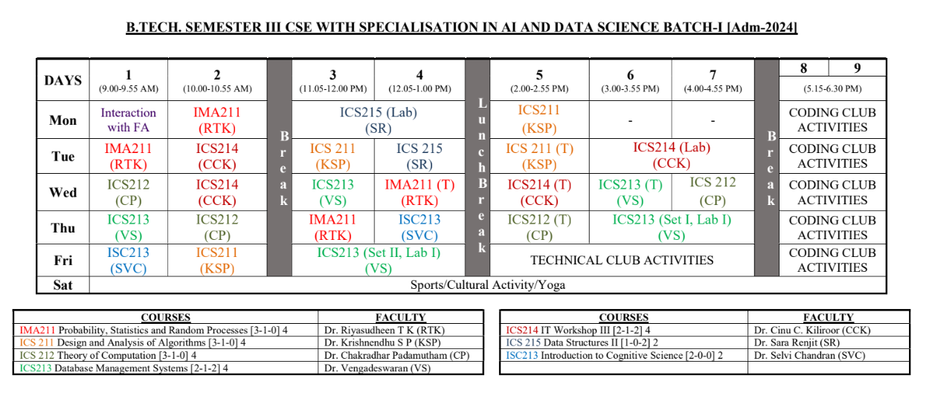
Timetable

Slide 10
Any more
Expectations
Suggestions
Requirements

Slide 11
Thank you

